Slide 1


ETHICS
New and Improved* Real and Potential Conflicts in Modern Practice
Kate McHaffie and Ian Finch
(*now with 50% more cartoons)

Slide 2
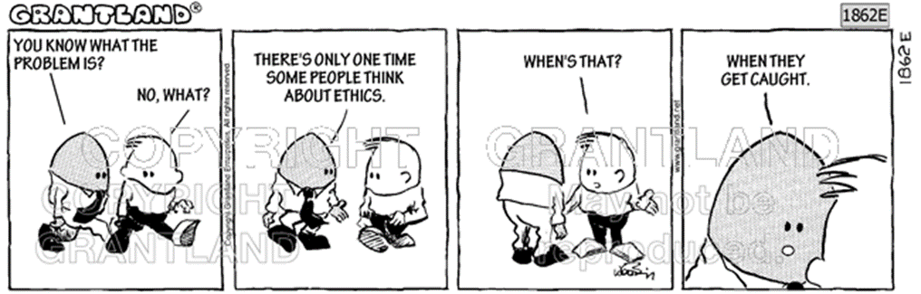
A Quick Refresher
Code of Conduct for Trans-Tasman Patent and Trade Marks Attorneys 2018
Guidelines to the Code 2018
No decisions yet issued under the Code
NZLS Rules of Conduct and Client Care
Ethics | Page 2

Slide 3
RCCC 6.1
A lawyer must not act for more than 1 client on a matter in any circumstances where there is a more than negligible risk that the lawyer may be unable to discharge the obligations owed to 1 or more of the clients.
6.1.1 Subject to the above, a lawyer may act for more than 1 party in respect of the same transaction or matter where the prior informed consent of all parties concerned is obtained.
6.1.2 Despite rule 6.1.1, if a lawyer is acting for more than 1 client in respect of a matter and it becomes apparent that the lawyer will no longer be able to discharge the obligations owed to all of the clients for whom the lawyer acts, the lawyer must immediately inform each of the clients of this fact and terminate the retainers with all of the clients.
Your firm acts for Client A. Client A licences its patent to Client B, who is also a client of your firm. Client B has a commercial product based on the patented technology about to go to market, and asks you to do an FTO search.
Can you act for Client B in this matter?
If yes, what should you do to minimise the risk of conflict arising?
Scenario 1

Slide 4
COC 20 Conflicts
A registered attorney must avoid creation of a situation giving rise to an actual conflict or the reasonable possibility of a conflict: (a) between the registered attorney’s interests and the interests of a current client; and (b) between the interests of one current client over the interests of another current client.
Upon becoming aware of a situation giving rise to an actual conflict or the reasonable possibility of a conflict of the types described in subsection (1), a registered attorney must take steps, as soon as practicable, to resolve the actual conflict or the reasonable possibility of a conflict
Your firm acts for Client A. Client A licences its patent to Client B, who is also a client of your firm. Client B has a commercial product based on the patented technology about to go to market, and asks you to do an FTO search.
Can you act for Client B in this matter?
If yes, what should you do to minimise the risk of conflict arising?
Scenario 1

Slide 5
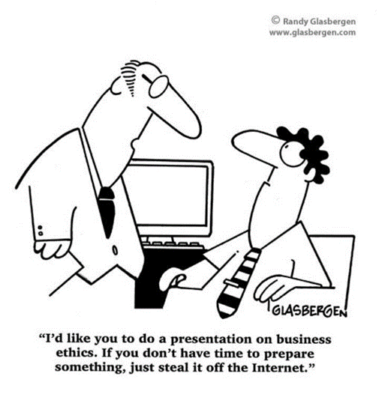
You receive an unsolicited enquiry from a business that has been using ESPRIT FINANCE for four years and wants to register the mark. They have conducted a trade mark search and have discovered that there is a trade mark registration for ESPRIT in relation to financial services and the mark does not appear to be in use. They have sought your advice, and specifically mentioned revocation.
You act for the owner of the ESPRIT mark mentioned in the email. Can you:
Contact the owner of the ESPRIT mark to tell them their registration is under threat and that they should take immediate action (e.g. file a new application); and/or
(2) Disclose the email enquiry itself?
RCCC 7
A lawyer must promptly disclose to a client all information that the lawyer has or acquires that is relevant to the matter in respect of which the lawyer is engaged by the client
LCA s4, RCCC 2
Every lawyer who provides regulated services must, in the course of his or her practice, comply with the following fundamental obligations:
the obligation to uphold the rule of law and to facilitate the administration of justice in New Zealand
Scenario 2

Slide 6
COC 13 Integrity
(1) A registered attorney must not act as a patent attorney or a trade marks attorney in a way that is fraudulent, deceitful or knowingly misleading.
(2) A registered attorney must maintain standards of professional practice as a patent attorney or a trade marks attorney that are courteous, ethical and well-informed.
COC 11 Core Obligations
(1) A registered attorney must act as a patent attorney or a trade marks attorney:
(a) in accordance with the law; and
(b) in the best interests of the registered attorney’s clients; and
(c) in the public interest; and
(d) in the interests of the registered attorney’s profession as a whole.
You receive an unsolicited enquiry from a business that has been using ESPRIT FINANCE for four years and wants to register the mark. They have conducted a trade mark search and have discovered that there is a trade mark registration for ESPRIT in relation to financial services and the mark does not appear to be in use. They have sought your advice, and specifically mentioned revocation. You act for the owner of the ESPRIT mark.
Scenario 2

Slide 7
COC 17 Disclosure
Unless prohibited by section 18 [confidentiality] or otherwise by law, a registered attorney that is an individual must disclose to a client all information of which the registered attorney is aware that is materially relevant to work being undertaken for the client.
COC 18 Confidentiality
Unless permitted or required by law, a registered attorney must not use or disclose, or allow to be used or disclosed, confidential information obtained from or on behalf of a client, a former client or a prospective client without the informed consent of the client.
You receive an unsolicited enquiry from a business that has been using ESPRIT FINANCE for four years and wants to register the mark. They have conducted a trade mark search and have discovered that there is a trade mark registration for ESPRIT in relation to financial services and the mark does not appear to be in use. They have sought your advice, and specifically mentioned revocation. You act for the owner of the ESPRIT mark.
Scenario 2

Slide 8
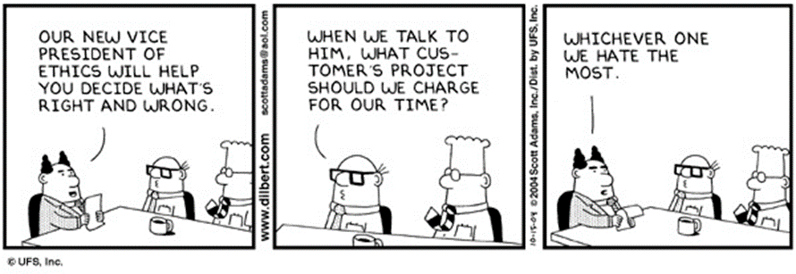
COC 18 Disclosure
Unless permitted or required by law, a registered attorney must not use or disclose, or allow to be used or disclosed, confidential information obtained from or on behalf of a client, a former client or a prospective client without the informed consent of the client.
In 2014 Company A seeks some advice from your firm regarding registration of its trade marks. It files the marks according to the advice but through another firm. Your firm has done no other work for Company A.
This year your firm filed some similar trade marks for Company B. Company A has opposed the marks and claims you have a conflict of interest representing Company B.
Can you act for Company B?
Scenario 3
Ethics | Page 8

Slide 9
COC 19 Loyalty
(6) A registered attorney must not act for a client in a matter knowing that the client’s interests are adverse to the interests of a former client unless:
(a) the registered attorney does not hold confidential information relevant to the matter obtained from or on behalf of the former client; or
(b) where the registered attorney does hold confidential information relevant to the matter obtained from or on behalf of the former client – the registered attorney has established an effective information barrier in relation to the relevant confidential information.
Would it make a difference if Company A was an overseas corporate instructing you through an associate vs a local client?
Would it make a difference if Company A sought the trade mark advice in 2004?
Would it make a difference if you did / didn’t charge Company A for the trade mark advice?
Would it make a difference if you also did patent work for Company A?
Scenario 3

Slide 10
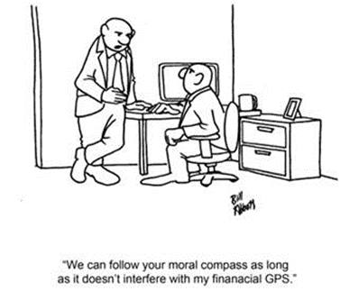
RCCC Chapter 8 Confidential information
8.1 A lawyer’s duty of confidence commences from the time a person makes a disclosure to the lawyer in relation to a proposed retainer (whether or not a retainer eventuates). The duty of confidence continues indefinitely after the person concerned has ceased to be the lawyer’s client.
In 2014 Company A seeks some advice from your firm regarding registration of its trade marks. It files the marks according to the advice but through another firm. Your firm has done no other work for Company A.
This year your firm filed some similar trade marks for Company B. Company A has opposed the marks and claims you have a conflict of interest representing Company B.
Can you act for Company B?
Scenario 3

Slide 11
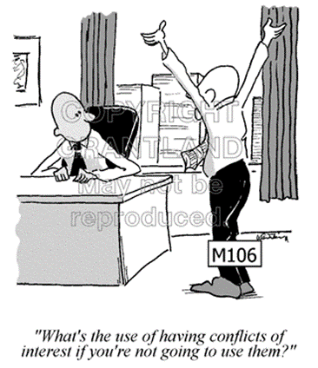
RCCC 4.1
Good cause to refuse to accept instructions includes a lack of available time, the instructions falling outside the lawyer’s normal field of practice, instructions that could require the lawyer to breach any professional obligation, and the unwillingness or inability of the prospective client to pay the normal fee of the lawyer concerned for the relevant work.
Can you refuse to act for a client who:
is engaged in a business you object to (tobacco, weapons manufacture, pornography)?
doesn’t pay their bills?
Scenario 4

Slide 12
RCCC 4.1
The following are not good cause to refuse to accept instructions:
(a) any grounds of discrimination prohibited by law including those set out in section 21 of the Human Rights Act 1993;
(b) any personal attributes of the prospective client; and
(c) the merits of the matter upon which the lawyer is consulted.
COC 14 Competency
A registered attorney must have appropriate competency for the work that the registered attorney undertakes.
A registered attorney must carry out the work that the registered attorney undertakes with due skill and care.
Can you refuse to act for a client who:
is engaged in a business you object to (tobacco, weapons manufacture, pornography)?
doesn’t pay their bills?
Scenario 4
Ethics | Page 12

Slide 13
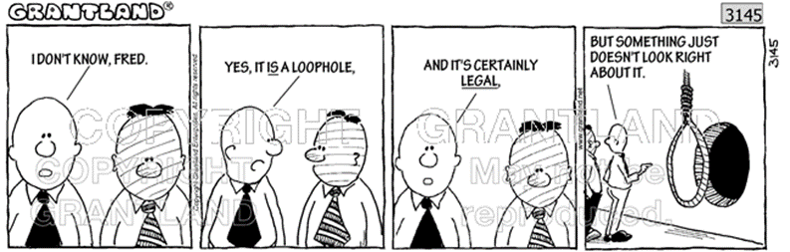
COC 19 Loyalty
(3) Subject to subsection (4), a registered attorney must not prefer the interests of one client over the interests of another client.
Client A, represented by Attorney A in your firm, wants to take action against Client B, represented by Attorney B in your firm. Can you choose which client to act for? If so, on what basis?
Scenario 5

Slide 14
COC Guidelines 13 Integrity
A registered attorney:
(b) must not knowingly make a false or misleading statement in relation to work done for a client or a prospective client; and
(c) must not prepare, or assist in the preparation of, a document in relation to a matter if the registered attorney knows, or ought reasonably to know, that the document contains a false or misleading statement; and
(d) must not file, or assist in the filing of, a document in relation to a matter if the registered attorney knows, or ought reasonably to know, that the document contains a false or misleading statement; and
(e) must not wilfully misrepresent facts or otherwise mislead another person in relation to a matter.
You are drafting a patent specification for a client. Your client discloses to you the existence of a piece of potentially invalidating prior art that the examiner hasn’t found. What are your obligations?
Scenario 6

Slide 15
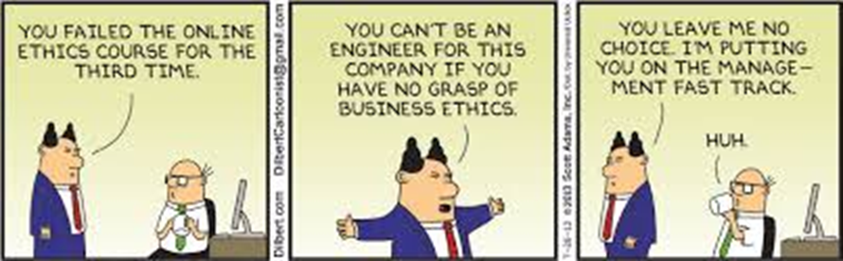
COC 19 Loyalty
(6) A registered attorney must not act for a client in a matter knowing that the client’s interests are adverse to the interests of a former client unless:
(a) the registered attorney does not hold confidential information relevant to the matter obtained from or on behalf of the former client; or
(b) where the registered attorney does hold confidential information relevant to the matter obtained from or on behalf of the former client – the registered attorney has established an effective information barrier in relation to the relevant confidential information.
You’ve been asked to advise a client on options for overcoming several TM citations. You find that one of the cited marks was filed and prosecuted by you, although you no longer act for the owner of that mark.
Can you advise the client?
Are there any steps you should take before doing so?
Scenario 7

Slide 16
COC 20 Conflicts
(1) A registered attorney must take all reasonable steps to avoid creation of a situation giving rise to an actual conflict or the reasonable possibility of a conflict:
(b) between the interests of one client and the interests of another client.
(2) Upon becoming aware of a situation giving rise to an actual conflict or the reasonable possibility of a conflict of the types described in subsection (1), a registered attorney must take steps, as soon as practicable, to resolve the actual conflict or the reasonable possibility of a conflict.
You have worked for Client A for many years. A couple of employees from Client A leave to set up their own business in the same industry. They contact you for some advice. What should you do?
Scenario 8

Slide 17
COC 19 Loyalty
(3) A registered attorney must not prefer the interests of one current client over the interests of another current client.
(4) Subject to subsection (5), a registered attorney must not act for a client in a matter knowing that the client’s interests are adverse to the interests of another current client of the registered attorney unless: (a) both clients in writing have given reasonably informed consent to the registered attorney acting in the matter; and (b) where the registered attorney holds confidential information relevant to the matter obtained from or on behalf of either client – the registered attorney has established an effective information barrier in relation to the relevant confidential information.
You act for Party A, an NZ company, including instructing its overseas filings. Your UK agent tells you that a notice of opposition has been filed against Party A’s UK TM Application by Party B, citing Party B’s UK TM Registration DRAGON. Your firm prosecuted Party B’s NZ TM Registration DRAGON, and are still the address for service.
What should you do?
Does it make a difference if you filed Party B’s TM Application, or picked it up as an international application?
Would it make a difference if you had prosecuted a different TM for Party B?
Scenario 9

Slide 18
COC 19 Loyalty
(2) A registered attorney must not prefer the registered attorney’s own interests over the interests of a client.
(4) Subject to subsection (5), a registered attorney must not act for a client in a matter knowing that the client’s interests are adverse to the interests of another current client of the registered attorney unless: (a) both clients in writing have given reasonably informed consent to the registered attorney acting in the matter; and (b) where the registered attorney holds confidential information relevant to the matter obtained from or on behalf of either client – the registered attorney has established an effective information barrier in relation to the relevant confidential information.
(5) A registered attorney must not act for two or more clients in the same matter relating to proceedings before a court, a tribunal or a like adjudicative body where the registered attorney knows the clients’ interests are or are likely to be adverse.
There are currently three main listed IP firms in Australasia: IPH, Qantm, and Xenith. IPH employs 27% of all registered patent attorneys in Australasia and files 44% of patent applications in Australia. Qantm employs 12% and files 16%.
Can IPH buy a 19% stake in Qantm? What steps should it reasonably take before / after doing so?
Scenario 10

Slide 19
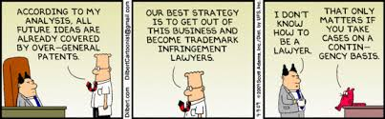
Questions?
Ethics | Page 19

