Slide 1
Pitching in:
Raising profiles and building relationships
Megan Campbell

Slide 2
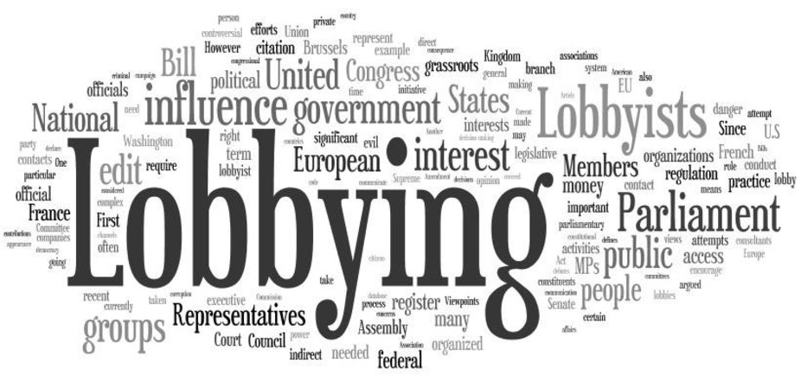
The ‘L’ word

Slide 3
Lobbying and Advocacy
Lobbying is not an inherent evil – It can provide valuable information to government and prevent bad policies being enacted
Information provided by lobbyists and advocates often provides a reality check to the advice supplied by bureaucrats and academics
Lobbying is done by business, NFPs, Unions, Environmental groups, kindergartens…

Slide 4
Relationships
Everything in politics is about relationships
Get to know the decision makers – need multiple ‘touches’ for them to know you
Recognise that someone who may be an opponent today could be an ally in the future
Always consider ways that you can meet more people, grow your relationships and make the connections

Slide 5
Who should lobby?
NZIPA Executive do the Lion’s share in the interests of patent attorneys
Some firms are active in the advocacy of the profession and value to the economy
Opportunity for all NZIPA members to be a part of growing a positive relationship with Government and wider industry

Slide 6
How can you lobby?
Make a deliberate engagement plan
Get to know your politicians – know their names, roles, background, political leanings, influences, electorate issues and find ways to connect them to what you do or your clients
Invite politicians and officials to events, drinks, presentations, board meetings, coffee or for site visits.
When you see them at other events, talk to them!
Notes:
Ask a couple of people in the audience

Slide 7
What do you talk about?
Always introduce yourself (every time unless they greet you by your name)
Consider how much time you have with them
Talk about your firm and your clients
Give case studies – politicians often talk about ‘cool’ stuff they heard about or saw
Invite them to your office or at a client’s farm, factory, boardroom
Make sure there is room in the conversation for them to talk back
Notes:
Ask a couple of people in the audience

Slide 8
Submission writing
Don’t leave it all up to the Executive!
Use plain English
Organise your thoughts to ensure easy reading. Consider the reader
Make sure you are relevant and not outside the scope
Don’t feel that you have to cover all aspects of a bill; cover what is most important to you, your firm or your clients
Be concise
Fact check and reference
Use personal experiences, case studies and stories
Provide conclusions and recommendations
Notes:
MPs relate to real stories – so if X change to legislation happened, the effect on X firm (potentially in X electorate) would be X

Slide 9
Presenting a submission
Confirm total time allocated to you including questions before arriving
Always introduce yourself
Don’t read your submission
Focus on key points and your recommendations
Direct your presentation to the Chair who will then redirect to others for questions

Slide 10
Things to consider
Don’t:
Threaten or act aggressively
Waste their time
Play politics
Get their name wrong
Forget the officials or the Opposition

Slide 11
Always
Be a good listener
Stay calm and rational AND be passionate
Try to understand where the politician or official is coming from
Be available with extra information
Don’t be a fair weather friend
Remember New Zealand is a small place
Notes:
We help as we know the pollies, how to tell the story in a way that can be heard, what touch stones different MPs have etc

