Slide 1
IPONZ – looking to the future
NZIPA conference
25 November 2016

Slide 2
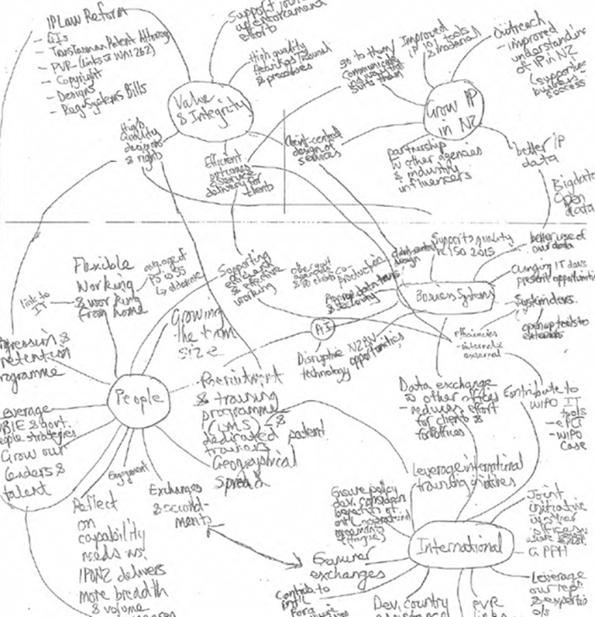
Five focus areas
Our people
Our systems
Value and integrity for clients
International collaboration
Grow IP in NZ
Our people
Value & integrity for clients
International collaboration
Our system
Grow IP in NZ

Slide 3
Grow IP awareness
Our people
Value & integrity for clients
International collaboration
Our system
Grow IP in NZ

Slide 4
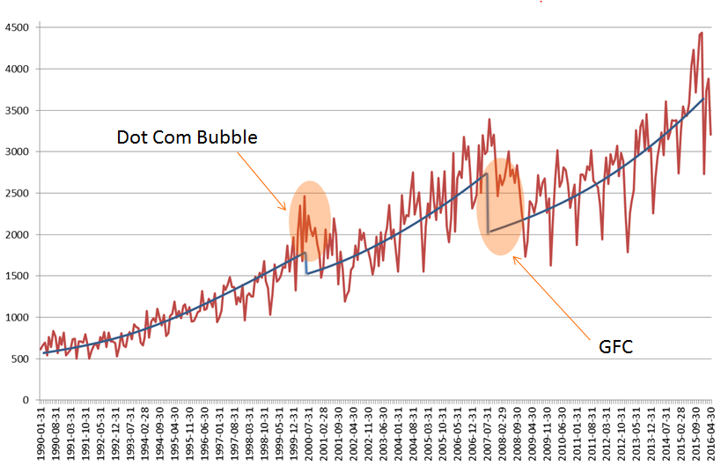
Trade Mark filings
Our people
Value & integrity for clients
International collaboration
Our system
Grow IP in NZ

Slide 5
High quality decisions and efficient outcomes
Trans-Tasman Patent Attorney regime
Geographical Indications
Patent and Trade Mark fee review
Plant Variety Act
Copyright and Designs
New Zealand Business Number (NZBN)
Our people
Value & integrity for clients
International collaboration
Our system
Grow IP in NZ

Slide 6
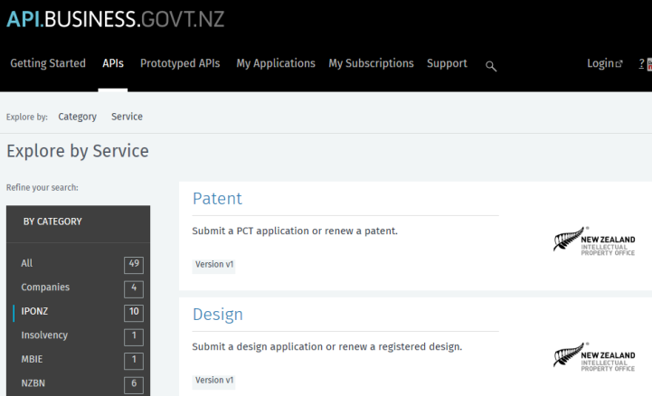
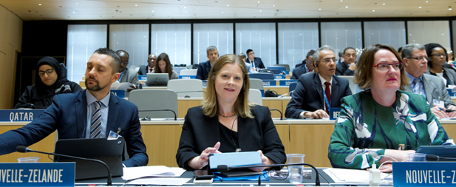
Our people
Value & integrity for clients
International collaboration
Our system
Grow IP in NZ

Slide 7
In five years
IPONZ will be:
Bigger and better connected
Administering new laws
Granting high quality rights
Our customers will have:
A better knowledge of IP
World leading IT services
Access to meaningful data
NZBN
Our people
Value & integrity for clients
International collaboration
Our system
Grow IP in NZ

Slide 8
Simon Gallagher
Acting National Manager, IPONZ

