Slide 1
Cyber Attack – Business Risk or IT Problem?

Slide 2

Agenda
        What is a cyber Attack
        Players to a cyber Attack
        Why are the attacks increasing?
        What can happen?
        Motivation Stats – Sept. 2016
        Common attacks in NZ
        Cyber attacks – No longer an IT issue
        Prevention - All about your Posture
        "C" suite Questions
        Re-evaluate
Notes:
This is the road or path I want to address today:
Sony Attack – North Korea backed (Guardians of Peace)
Ashley Madison
Tesco Bank

Slide 3

What is a Cyber Attack
        A cyberattack - Deliberate exploitation of computer systems, technology-dependent enterprises and networks.
      Cyberattacks - Use malicious code to alter computer code, logic or data, resulting in disruptive consequences that can compromise data and lead to cybercrimes, such as information and identity theft.

Slide 4
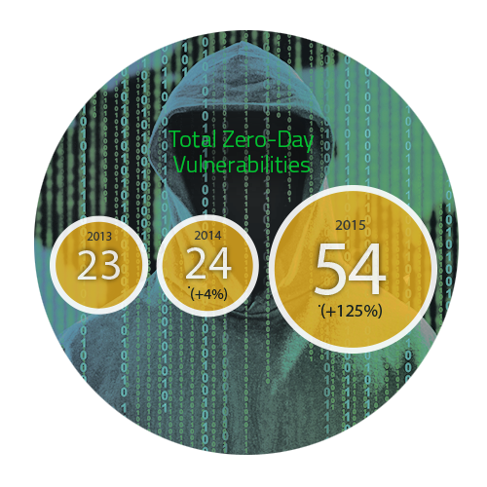
Players that pose a risk to information
        Cyber Criminals and Organised Crime ($3Trillion)
        Industrial espionage and nation states
        Hackers
        Hacktivists
        Employees / Users
        Vendors
Business Risk / IT Problem ???
Notes:
Hacktivists – Subversive use of computers and computer networks to promote political agendas
Users: Users with a grudge, users with access not checked and controlled and users with special privileges or ones that can escalate with permission
Current cyber attacks under GT with Dual Insurance

Slide 5

Why are the attacks Increasing?
        Government investment in cyber attacks
        Black market for security hacking tools
        Money and assets now vulnerable to cyber attack
        Increasing networking of systems and devices
        Increasing use of mobile technology and cloud
Notes:
Talk about the Internet of things
Mobile Banking and Commerce
Cloud – Security and effectiveness varies - Data can be comingled and data leakage and breach risks high if not controlled (due diligence most important)

Slide 6

Cyber Attack – What can happen??
Identity theft, fraud, extortion
Malware, Trojans and viruses
Stolen hardware, such as laptops or mobile devices
Denial-of-service
Breach of access
Website defacement
Intellectual property(IP) theft
Lost Revenue / Loss of Reputation Etc.

Slide 7
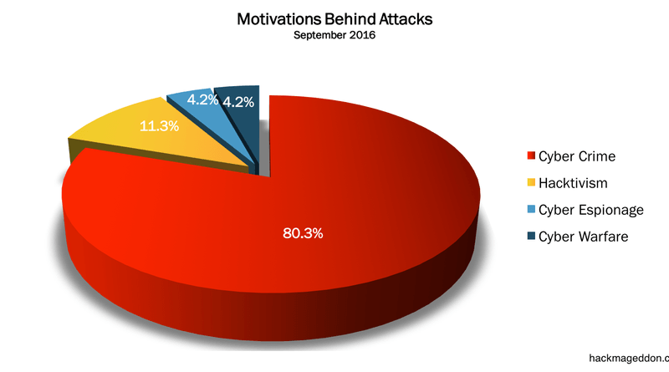
Cyber Attack Statistics – Motivations – Sept. 2016

Slide 8
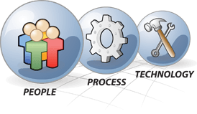
Common Attacks in NZ
        Ransomware (Cryptowall)
        Phishing / Spear phishing attacks
        Malware
        Denial of Service Attacks
        Social Engineering / Manipulation
        Physical and geographical events
        Vendor access and monitoring
        Data and Privacy Breach
Notes:
Data Breach – Doesn’t have to be electronic or digital to be a breach - Breach disclosure in NZ being very weak
Attacks cross the spectrum of what makes our organisation – PPT no matter how small or big - This is the cause as well as can be the fix to the problem (PPT coming together under a well oiled governance and monitored structure)

Slide 9
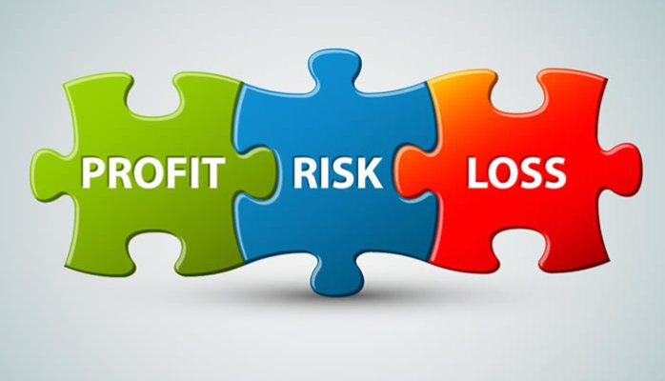
Cybersecurity/attacks: - "No longer only a Technical Issue or Risk"
        Need to move from the Technical Level to the Board Level
        Businesses need to get back to fundamentals
        Enterprise Risk - Whose responsibility for recovery in a disaster or business disruption is it anyway?
Notes:
Businesses need to include information security risk as an integral component of overall business risk (Practice risk centric is myopic and will be a costly mistake)

Slide 10

Cyber Risk – All about your posture
        Exposure (Critical Assets and Reliant Critical Business Functions)
        Data Management - Where is my Data (Does IT have it all??)
        Cloud – Using it or not? Are your clients demanding you use it?
        Access – Who has access and do you review that access periodically (Right and Right )
        Third parties – how are you reliant and by how much?? (monitored and/or not)
        Acceptable Use Policies and Standards
        Governance and Mandate
Notes:
Governance and mandate: It is the essential spinal chord to your information security posture, controls and protection

Slide 11

Cyber Security / Cyber Risk Challenge
"Organisation and C Suite Questions"
        Do we demonstrate due diligence, ownership, and effective management of cyber risk?
        Do we have the right leader and organisational talent?
        Have we established an appropriate cyber risk escalation framework that includes our risk appetite and reporting thresholds?
        Are we focused on, and investing in, the right things? And, if so, how do we evaluate and measure the results of our decisions?
        How do our cyber risk program and capabilities align to industry standards and peer organizations?
        Do we have a cyber-focused mind-set and cyber-conscious culture organisation wide?
        What have we done to protect the organization against third-party cyber risks?
        Can we rapidly contain damages and mobilize response resources when a cyber incident occurs?
        How do we evaluate the effectiveness of our organisation’s cyber risk program?

Slide 12
So Let's Revaluate?
        Is IT a Business Unit accountable for organisational policy adherence like any other?
        Who has overall mandate to drive information security governance and direction in the
        organisation?
        Who dictates the identification of / response to and recovery from cyber attack?
        Does Technology and the latest Technical Tools mean we are safe?
        Who can prevent "shadow IT" and areas of risk outside IT supervision and control ?
        Who can prevent or reduce the effects of a cyber attack?
Notes:
IT -Makes no difference if u use an outside provider for IT – They need to be monitored and controlled.
Cyber Threats and Cyber Risk – Are these business centric or IT centric?

Slide 13


